Slide 1

Exploiting multiphase slug flow for controlled manufacturing of uniform crystals
Mo Jiang

Slide 2
Enhance quality control and process efficiency
Crystal size distribution (CSD) and shape/morphology
Quality (e.g., color, bioavailability)
Washing, filtration, and milling
Formulation (e.g., tableting)
Challenges of CSD control
Simultaneous crystallization phenomena
(e.g., growth, particle attrition, agglomeration,
polymorphism, and secondary nucleation)
Batch-to-batch variability
Scale-up and operational problems
Jiang et al., The role of automatic process control in Quality by Design. In Comprehensive Quality by Design for Pharmaceutical Product Development and Manufacture, John Wiley & Sons, Hoboken, NJ, 2017.
2

Slide 3
Towards novel efficient and cost-effective crystallizers suitable for both development and manufacturing
Process intensification for continuous crystallization would
Minimize scale-up problems and time/cost, while retaining the advantages of the best previous continuous crystallizers
➔ This criterion would be met if the hydrodynamics
was consistent at both lab and production scales
Minimize operational problems (e.g., attrition, clogging)
➔ This criterion would be met if the hydrodynamics
provided sufficient mixing to replace mixing blades
3

Slide 4
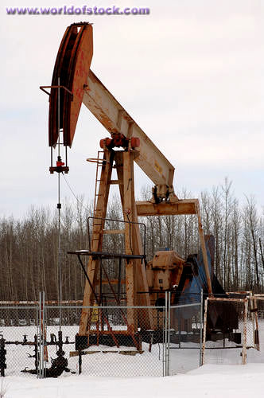
Approach: Exploit multiphase hydrodynamics
Plug
Stratified
Wavy
Slug
Dispersed
bubble
Annular
worldofstock.com
Ghajar. J. Braz. Soc. Mech. Sci., 27 (1), 46–73, 2005.
4

Slide 5
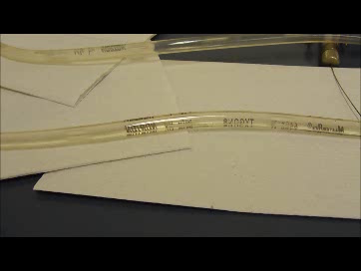
Slug flow for crystallization
Operate under conditions
where slugs spontaneously form
Grow crystals within each slug
Uniform T and C in each slug
Reduce scale-up risk (use same
slug and tube dimensions
at lab and production scales)
Separate control of crystal nucleation and growth
Video, slowed by 8 times
5

Slide 6
Slug-flow crystallization process design
Nucleate crystals
(e.g., in micromixers)
Generate liquid slugs
in tubing
Use spatially varying
temperature profile
Control nuclei
number density
Control dissolution and growth
in slugs
Achieve target CSD (e.g., uniform crystals)
Air
Temp 1
Temp 2
Temp 3
Temp 4
Solution
A
Air
Slurry
Air
Slurry
Air
Slurry
Slurry
Solution B
Nucleation
Slug formation
Controlled Growth
6

Slide 7
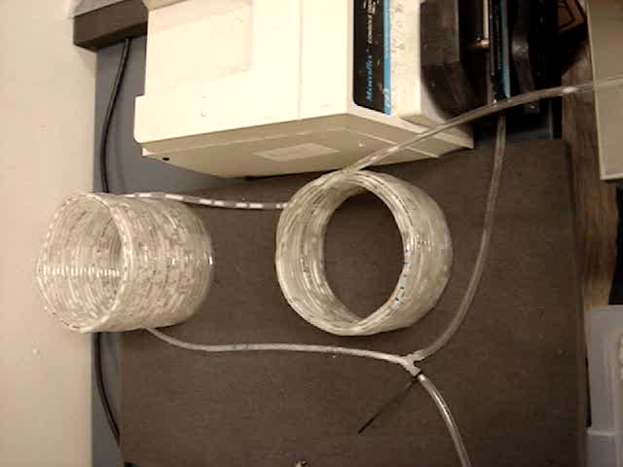
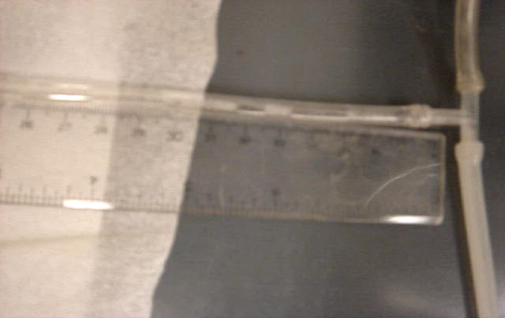
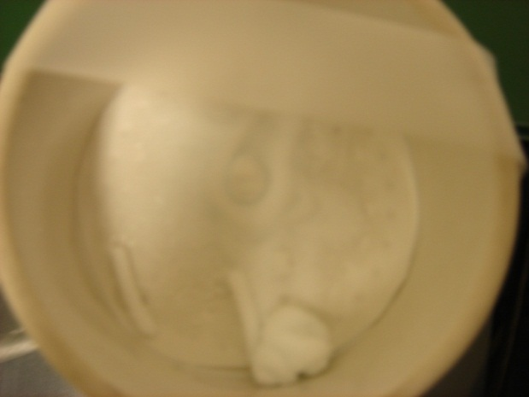
Demonstration of slug-flow crystallization
Air
Temp 1
Temp 2
Temp 3
Temp 4
Hot solution
Air
Slurry
Air
Slurry
Air
Slurry
Slurry
Cold solution
Video
LAM: L-asparagine monohydrate
High tendency to aggregate in H₂O
Handle high
solids density
Air
Slug
LAM slurry
Video
7

Slide 8
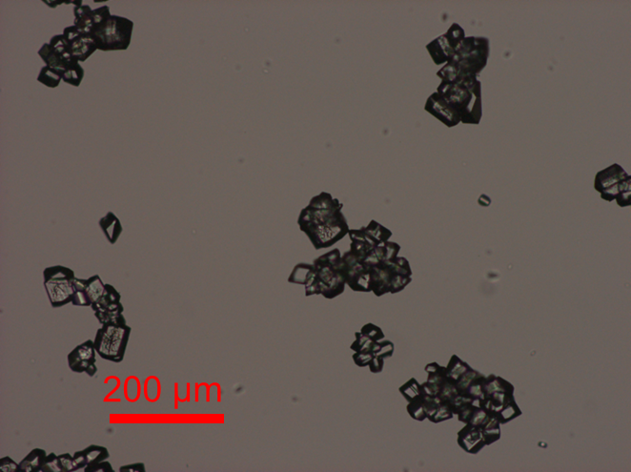
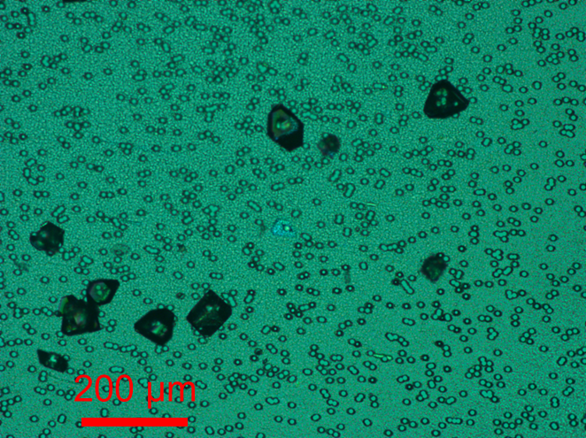
Improvement of mixing hydrodynamics
to increase seed size uniformity
Air
Temp 1
Temp 2
Temp 3
Temp 4
Hot solution
Air
Slurry
Air
Slurry
Air
Slurry
Slurry
Cold solution
Laminar flow
Coaxial mixer
200 µm
200 µm
200 µm
8

Slide 9
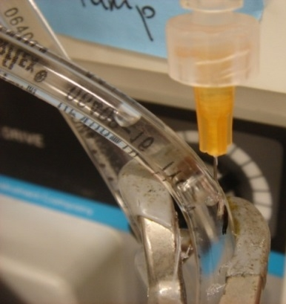
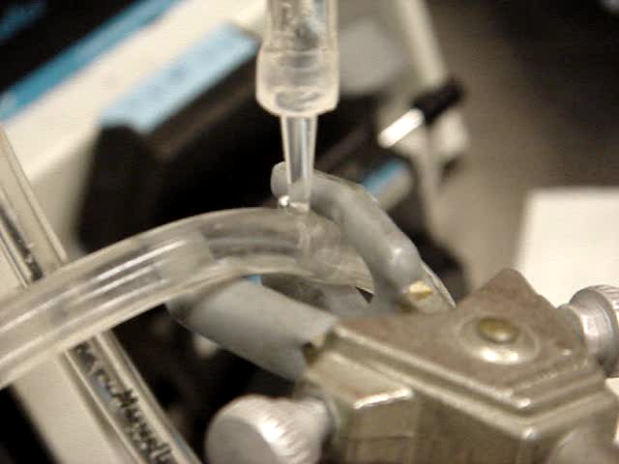
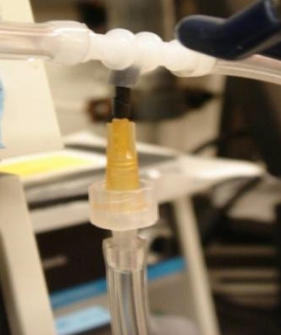
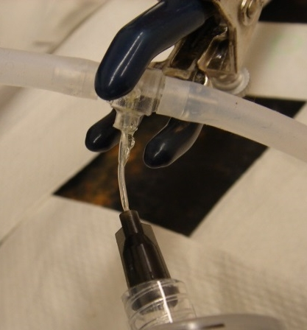
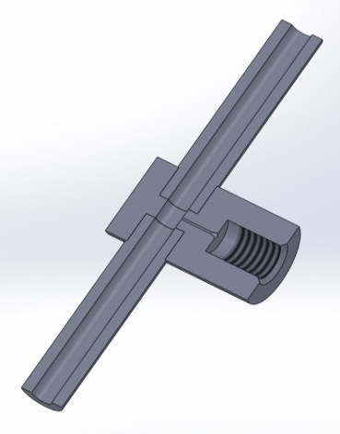
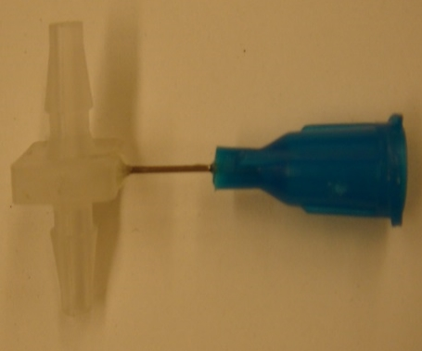
Micromixer prototypes for seed generation
Coaxial mixer
Radial mixers
Mixer criteria
Reproducible operations
Min-leakage connection
Minimize clogging
9

Slide 10


Improvement of slug aspect ratio to promote mixing
Aspect ratio goes up to 4
Aspect ratio ~ 1
Tubing wall
Tubing wall
Video
1 mm
Tubing wall
Video
1 mm
Tubing wall
Video is 16 times slower than real time.
Flow direction
Crystals in slugs with aspect ratio closer to 1 are more
spread out in the slug, more like a batch crystallizer.
The solution is better mixed with higher flow rate.
10

Slide 11
Nucleation in coaxial mixer and growth in slugs
Representative slug
Uncontrolled cooling
Coaxial mixers improved crystal uniformity, morphology, and
reduced aggregation compared to laminar flow
11

Slide 12
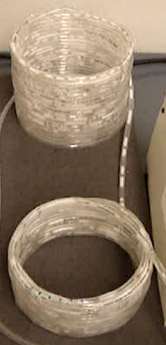
Summary
Designed experimental system to spontaneously generate stable slugs
with controlled aspect ratio, where
the temperature and concentration
are uniform due to recirculation
Generated high-quality large uniform crystals from a cooling slug-flow crystallizer,
with low scale-up risk
Enhanced size uniformity by improving nucleation with coaxial or radial mixers,
and improving growth by setting a controlled spatial temperature profile
12

Slide 13






Acknowledgments
Richard D. Braatz

Slide 14
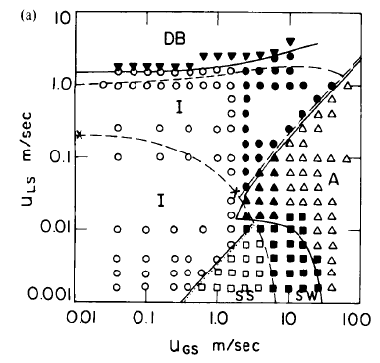
Operate in stable regime for self-induced slug flow
Tubing I.D. = 4 mm
My slug flow
operation
(3.1 mm I.D.)
Liquid velocity (m/s)
Gas velocity (m/s)
Barnea, Luninski, and Taitel. Can. J. Chem. Eng., 61 (5), 617–620, 1983.
5

Slide 15
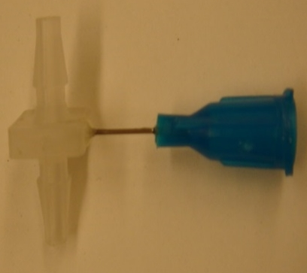
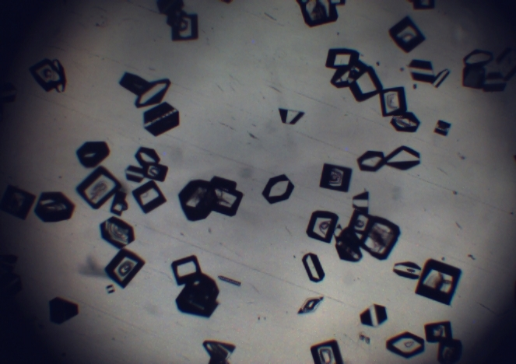
Crystals with nucleation from cooling micromixers
Coaxial mixer
Radial mixer
500 μm
15

Slide 16
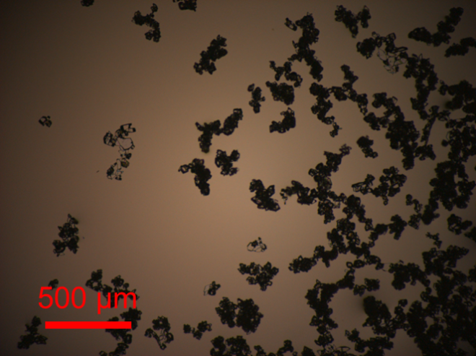
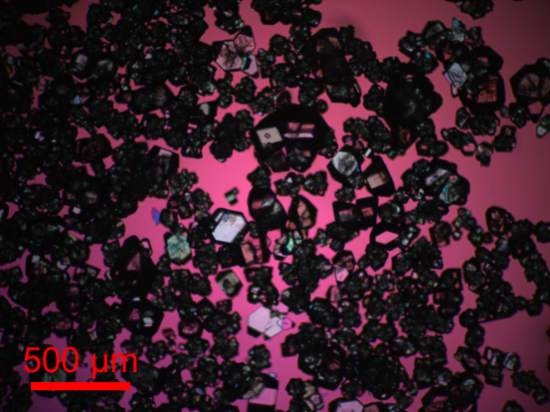
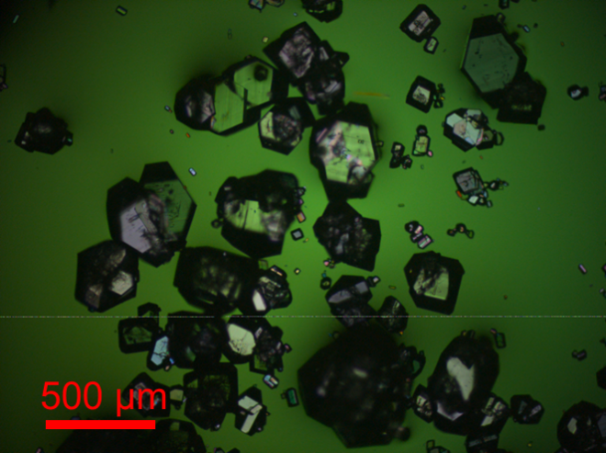
Crystal growth improvement with heating stage
500 µm
500 µm
500 µm
No heating stage
Heating
in aluminum tubing
Cooling in air
Heating
in aluminum tubing
Cooling in two temperature baths
Add heating stage
Controlled cooling stage
16

Slide 17
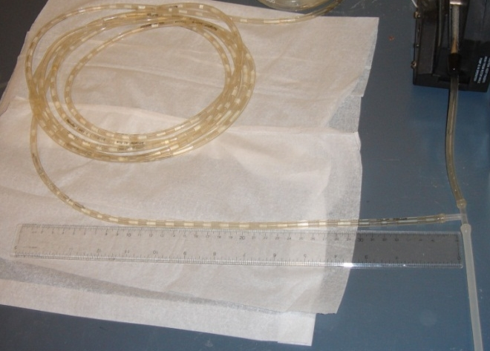
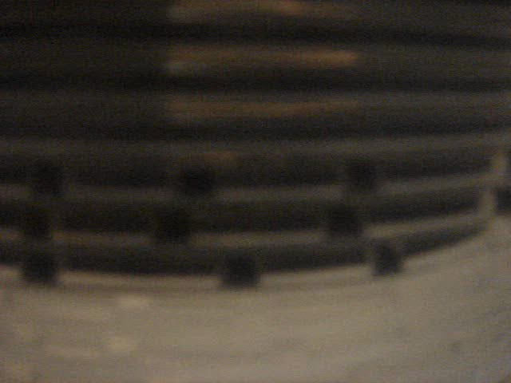
Slug size uniformity improvement by tube orientation
Air
Temp 1
Temp 2
Temp 3
Temp 4
Hot solution
Air
Slurry
Air
Slurry
Air
Slurry
Slurry
Cold solution
Video
Air
Slug
LAM slurry
17

Slide 18
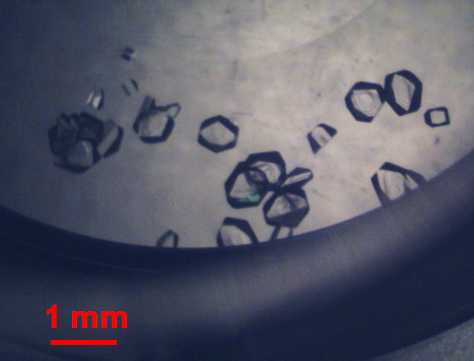
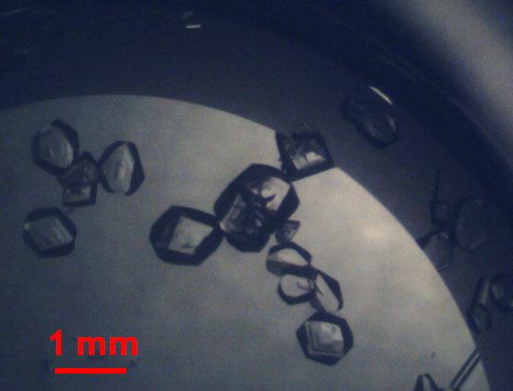
Nucleation in radial mixer and growth in slugs
Slugs #106-108
Slugs #286-288
Radial mixers also reduced aggregation compared to laminar flow
M. Jiang, et al. Continuous-flow tubular crystallization in slugs spontaneously induced by hydrodynamics. Crystal Growth & Design, 14 (2), 851–860, 2014.

